Slide 1
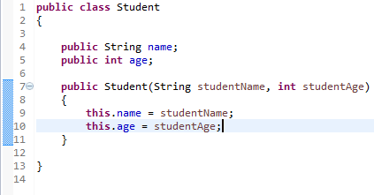
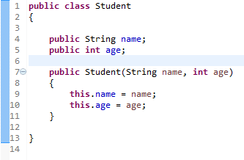
Using this with a Field
Each argument to the constructor shadows one of the object's fields — inside the constructor name is a local copy of the constructor's first argument. To refer to the Student field name, the constructor must use this.name.
We can write like below
The most common reason for using the this keyword is because a field is shadowed by a method or constructor parameter.
Within an instance method or a constructor, this is a reference to the current object — the object whose method or constructor is being called. You can refer to any member of the current object from within an instance method or a constructor by using this.

